Slide 1
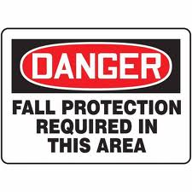
Fall Protection Sub-committee Update
MESH General Meeting
April 27.2017

Slide 2
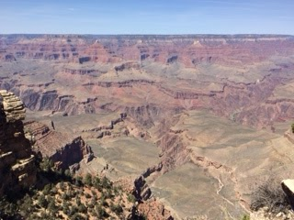
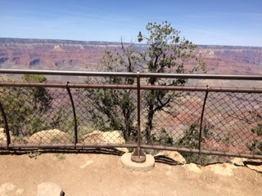
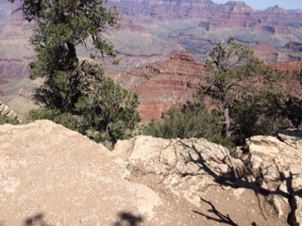
Fall Protection Sub-committee Update
Fall Protection at the Grand Canyon

Slide 3
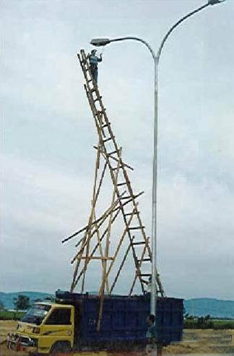
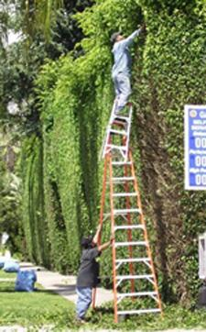
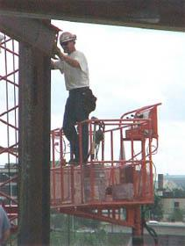
Fall Protection Sub-committee Update
Why is this important?
Falls are the most common cause of workplace injuries and deaths

Slide 4
Fall Protection Sub-committee Update
Objective: To identify fall protection opportunities in the mushroom industry and recommend practical / feasible solutions, which would be compliant to OSHA Standards, to resolve these safety issues

Slide 5
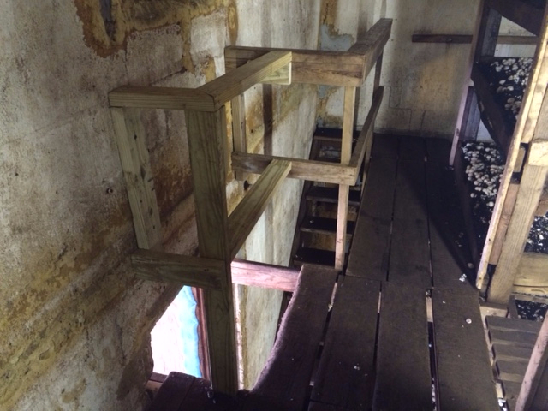
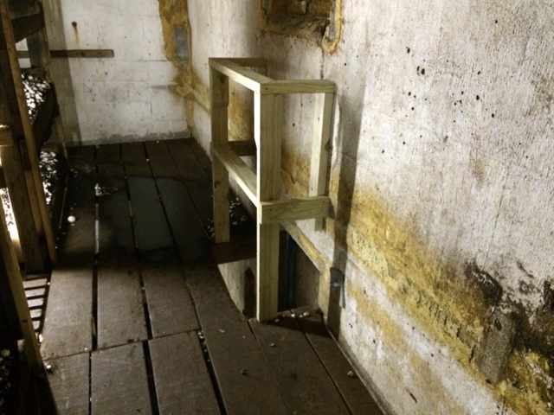
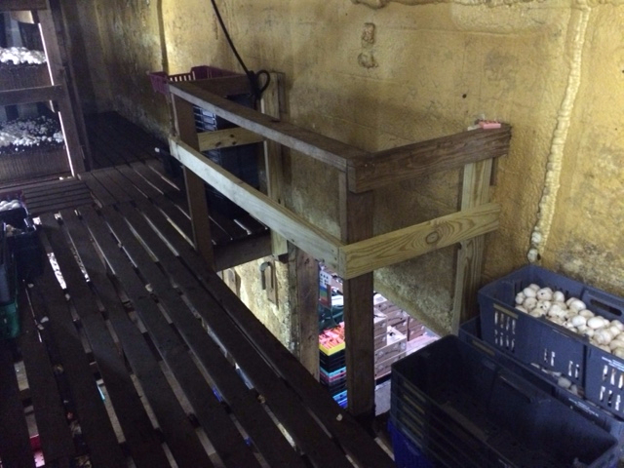
Fall Protection Best Practices
Guarding Around Stairway / Harvesting Tray Openings

Slide 6
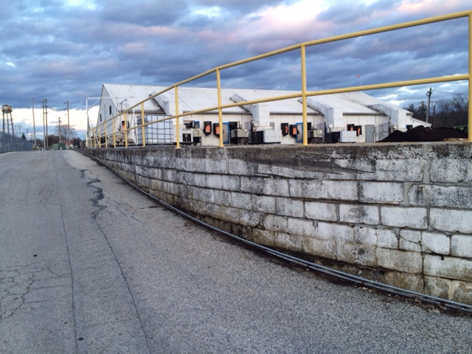
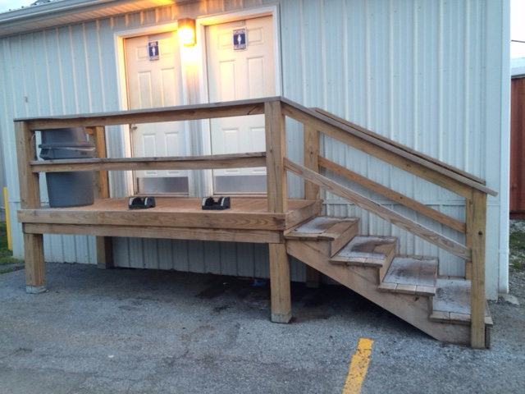
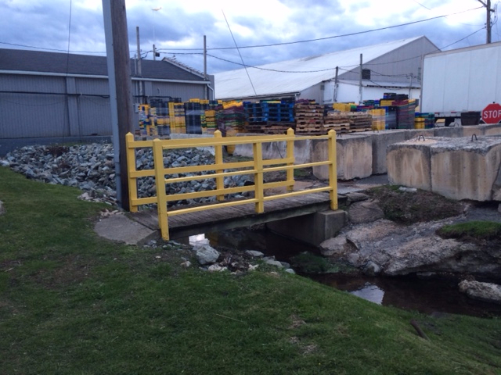
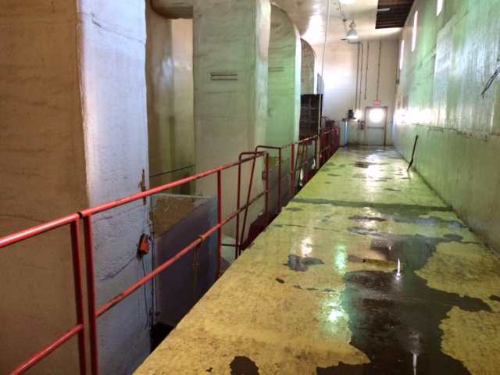
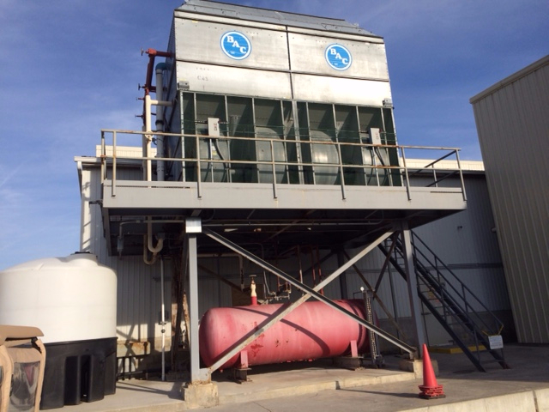
Fall Protection Best Practices
Railings around Work Platforms 4-6”above Ground

Slide 7
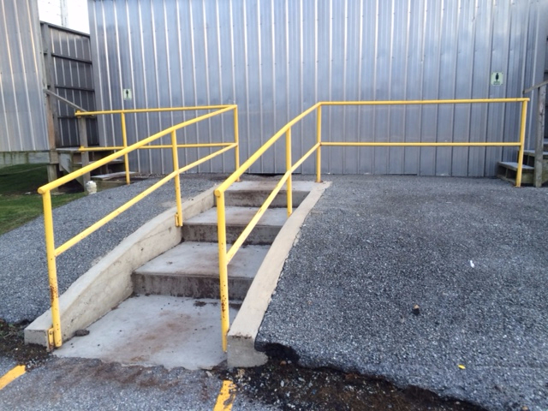
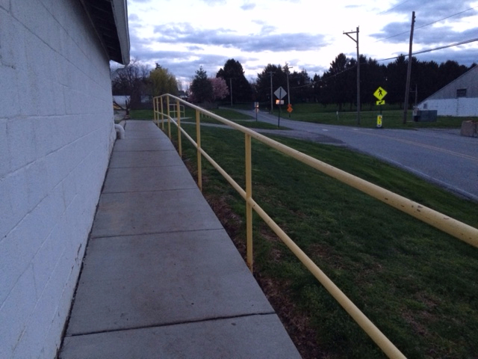
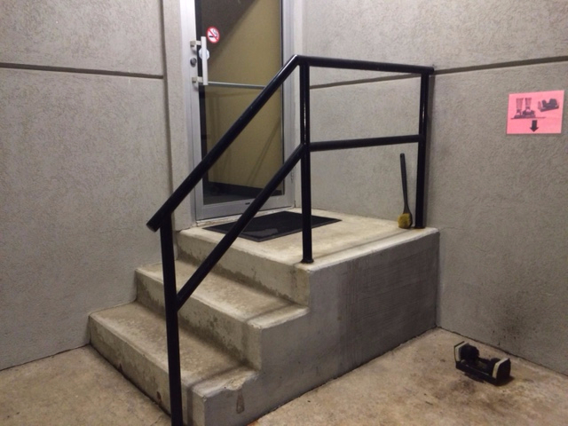
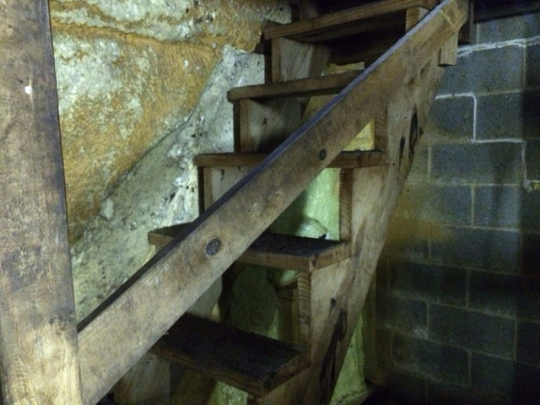
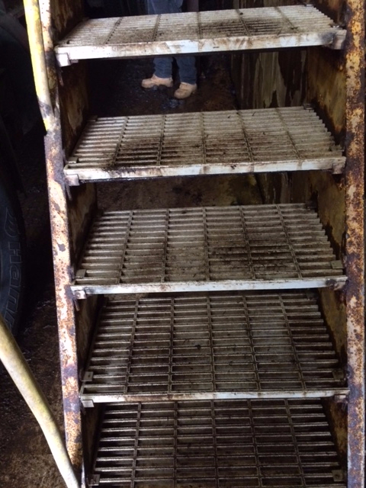
Fall Protection Best Practices
Slip-Resistant Tread on Stairs / Hand Railings

Slide 8
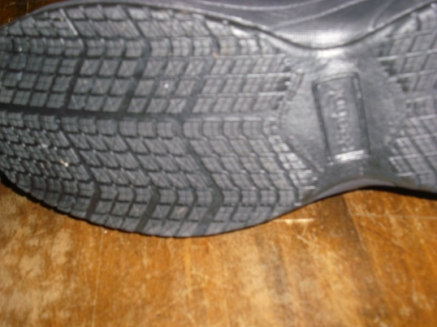
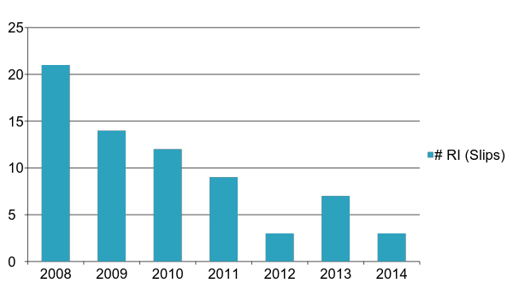
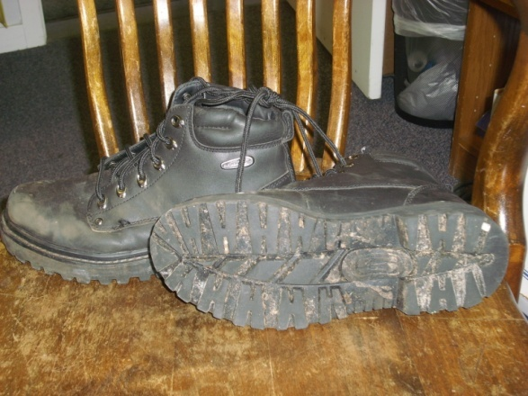
Fall Protection Best Practices
Slip-Resistant Shoe Program

Slide 9
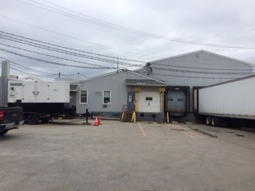
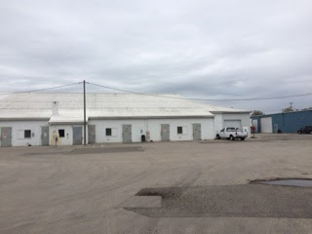
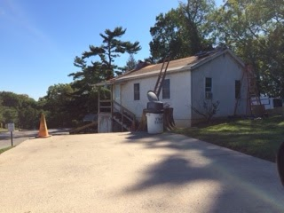
Fall Protection Sub-committee Update
Fall Protection Resource - Sales Solutions

Slide 10
Where do we stand?
Most mushroom doubles would be classified by OSHA as having a “steep roof” which is a roof that rises more than 4 inches over a distance of 12 inches and sits 6 feet above lower levels.
This requires that:
“Each employee on a steep roof with unprotected sides and edges 6 feet (1.8 m) or more above lower levels shall be protected from falling by guardrail systems with toeboards, safety net systems, or personal fall arrest systems.” 1926.501(b)(11)

Slide 11
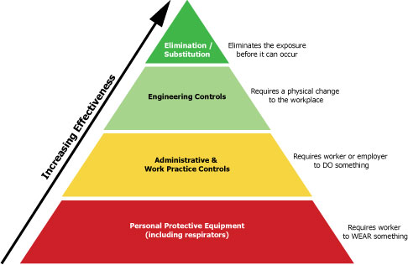

Slide 12
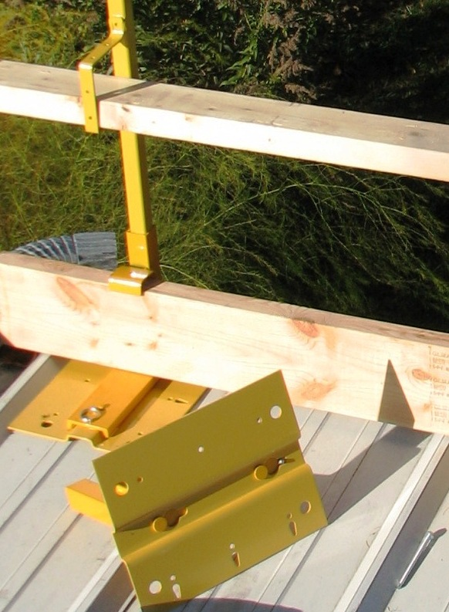
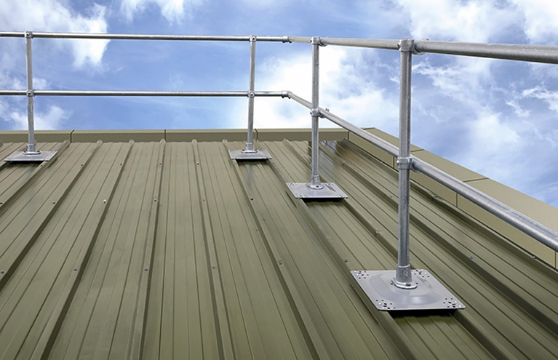
Engineering Controls
Guard rails
  Great for flat and low slope roofs.
  Ideal to prevent the fall from happening.
  Require minimal training.

Slide 13
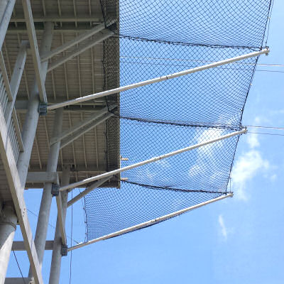
Engineering Controls
Safety nets
  Require a fall to occur before they are useful.
  Must be sufficiently tested.
  Limited application in the mushroom industry.

Slide 15
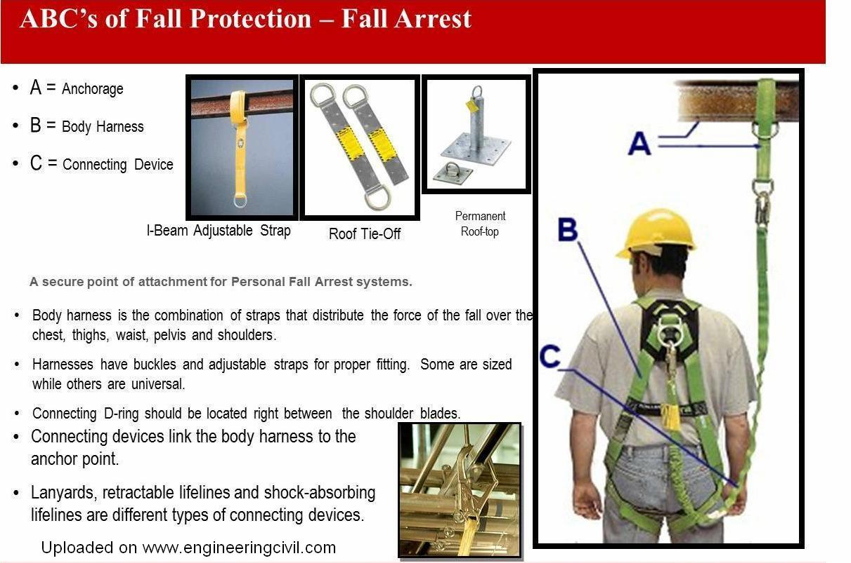
Notes:
Anchor points rated for 5,000 lbs per worker attached from layman or 2xmax arresting force from engineer

Slide 16
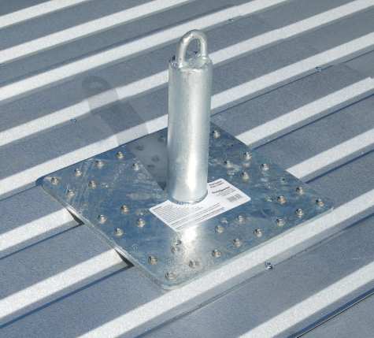
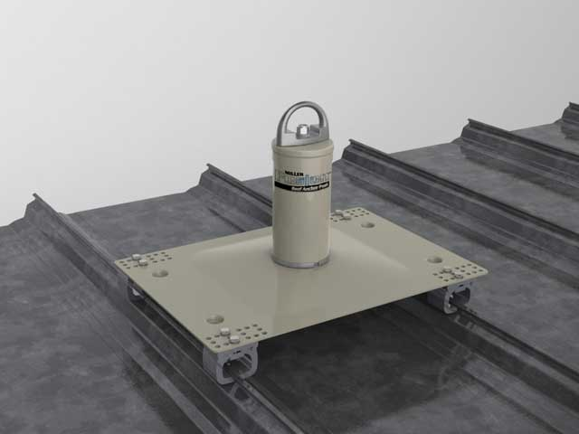
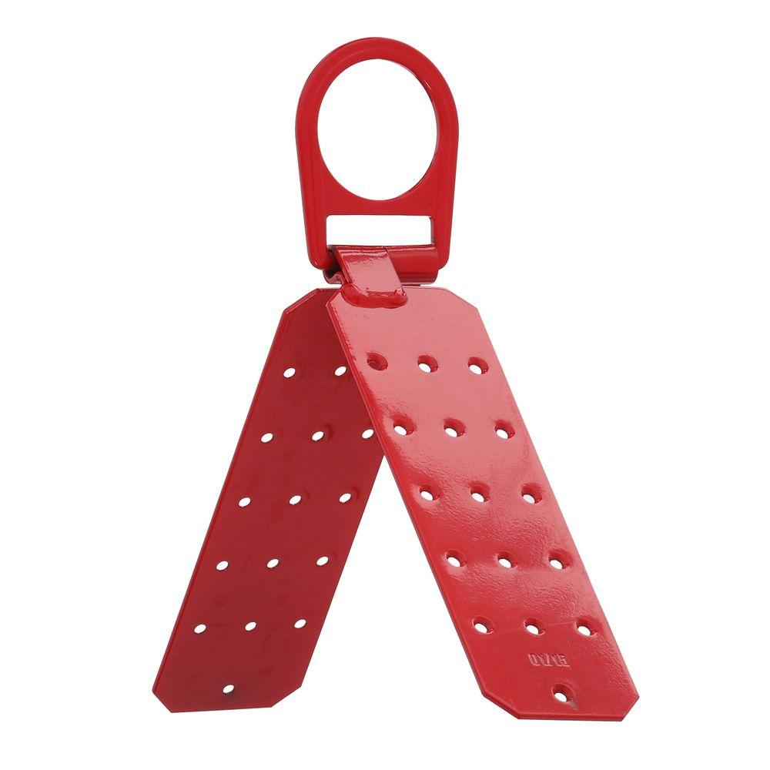
A: Anchors
PFAS anchors can be either permanent removable depending on the roof type.
5,000 lbs per worker attached; or
2 x the maximum arrest force (MAF = 1800lbs) per person if using an engineered system designed by a qualified person
Mounting point must also meet these specifications – evaluated by engineer

Slide 17
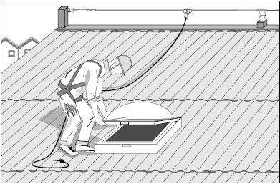
Notes:
“It is my recommendation that anchor points be installed and the use of a Temporary Horizontal Life Line System be used when workers must access the roof areas. “ Brian

Slide 18
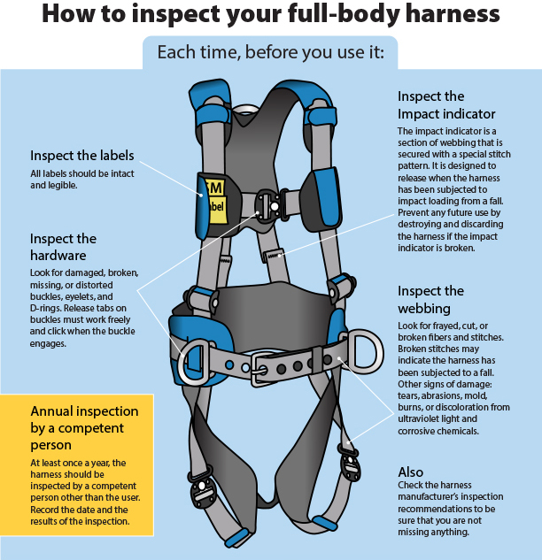
B: Body Harness
Notes:
body belts and non-locking snaphooks are not acceptable as part of a personal fall arrest system.
Connectors shall be made of drop forged, pressed, or formed steel or shall be made of materials with equivalent strength.
Connectors shall have a corrosion-resistant finish, and all surfaces and edges shall be smooth to prevent damage to the interfacing parts of the system.
D-rings and snaphooks shall be capable of sustaining a minimum tensile load of 5,000 pounds (22.24 Kn).
D-rings and snaphooks shall be proof-tested to a minimum tensile load of 3,600 pounds (16 Kn) without cracking, breaking, or being permanently deformed.

Slide 19
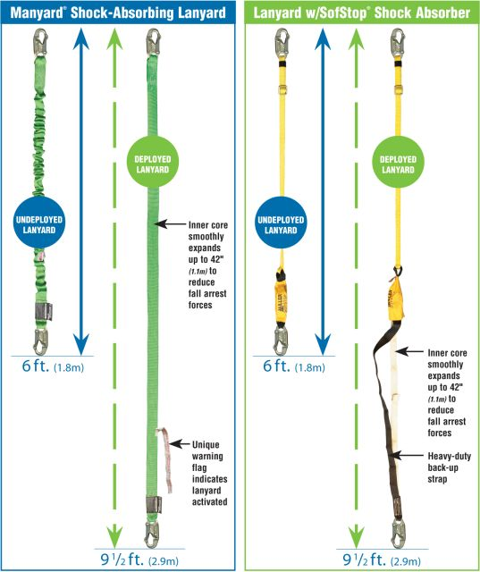
C: Connecting Devices
Connecting devices come in a wide variety of types to cover each specific roofing need but all must meet the following characteristics:
The maximum free fall allowable in fall arrest is 6 feet
The maximum deceleration distance allowable is 3.5 feet
The maximum arrest force is 1800lbs

Slide 20
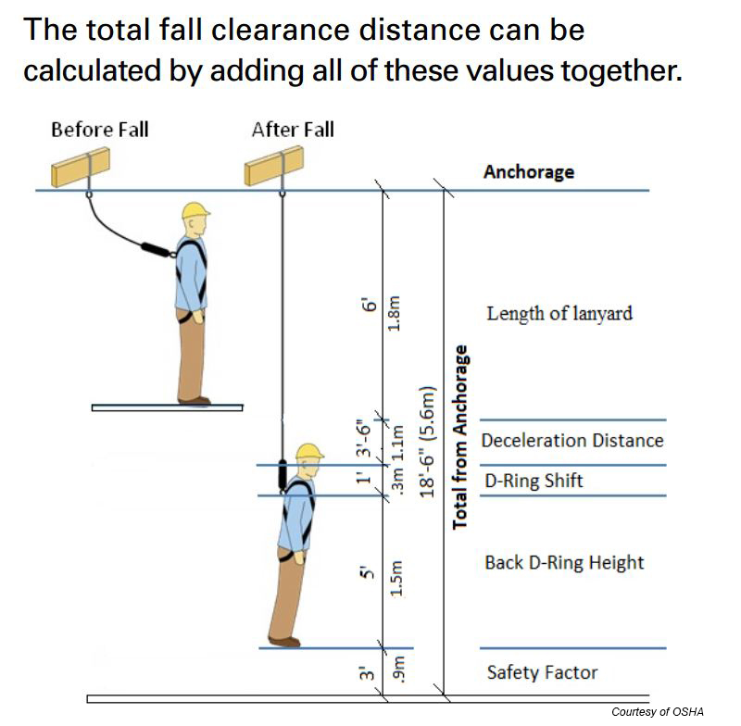

Slide 21
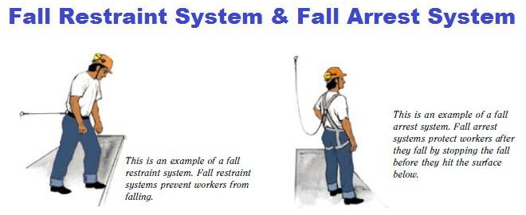
Notes:
ANSI Z359.3 states that fall restraint can only be used in areas with a slope between 0 and 18.4°. In the event that an area that is outside of those angles needs to be covered, a worksite will need to use fall arrest equipment in order to maintain compliance with ANSI code.

Slide 23
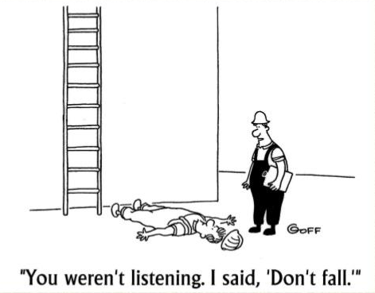
Administrative Controls

Slide 24
Administrative Controls
Establish your policies and training
  These should apply for all of your contractors.
Should something happen and they aren’t in compliance, you will still be liable.
Outline your safety requirements in your contract
Make their safety your priority.

Slide 25
Fall Protection Sub-committee Update
Thank you for your time.
Any questions?
Topics for future investigation?

