Slide 1

ERGONOMICS Sub-COMMITTEE
MESH Committee General Meeting
April 27,2017

Slide 2
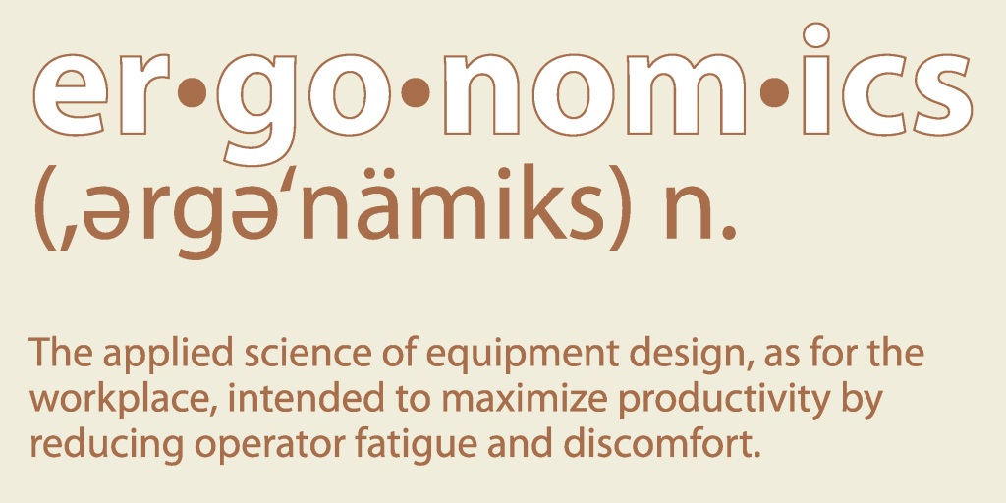

DEFINITION

Slide 3
OBJECTIVE
To create a practical ergonomics program for the mushroom industry that focuses on all areas of work by encompassing the following two subjects:
  Developing safe body positions for different jobs, including both behavioral and engineering adjustments
  Developing a stretching program designed with specific job hazards in mind

Slide 4

OVERALL GOALS
Reduce muscular-skeletal stress on employees due to work positions of specific mushroom industry jobs
Reduce injuries caused by strains/sprains and repetitive motions
Boost overall awareness of healthy living through stretching

Slide 5
FUTURE GOALS
Work with a Physical Therapist to develop written and training programs
Create and conduct a Train-the-Trainer program for companies to implement in their workforce

Slide 6
FUTURE GOALS
(CONT.)
Have training materials developed, such as posters, wallet size cards, PowerPoints, etc. to help teach employees proper stretching techniques and ergonomic positions
Design and produce different engineering changes for different jobs in the mushroom industry to remove ergonomic hazards

Slide 7
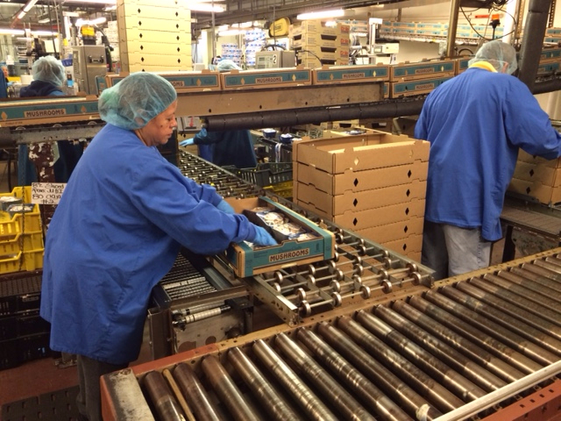
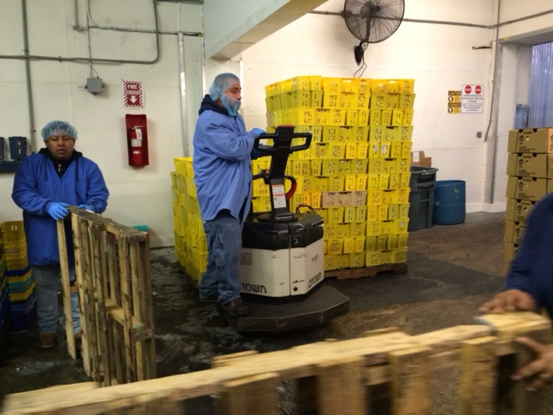
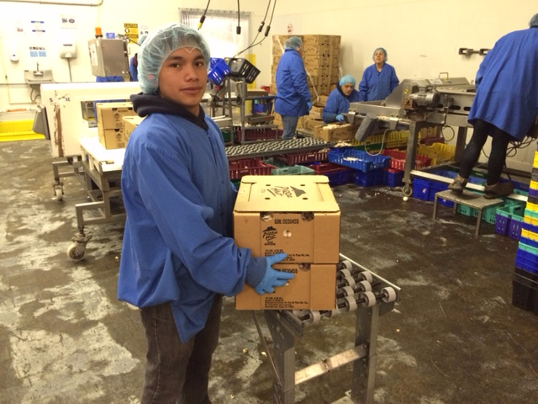

PACKING

Slide 8
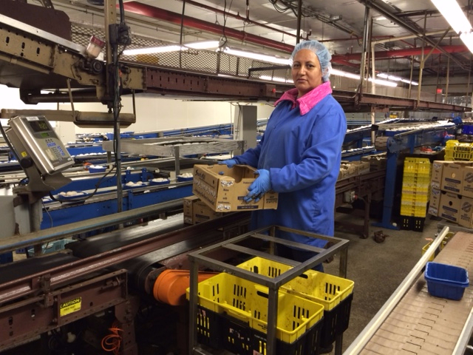
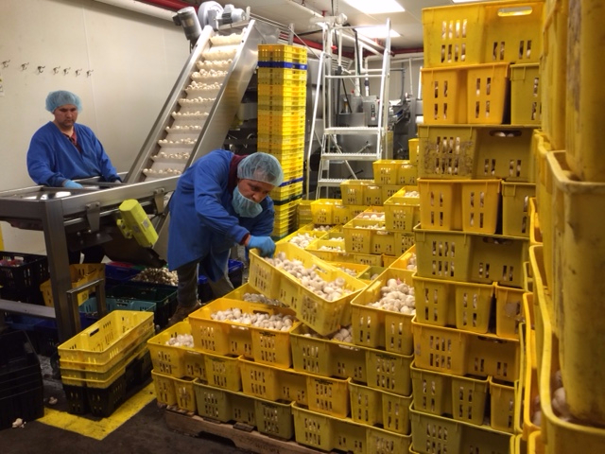
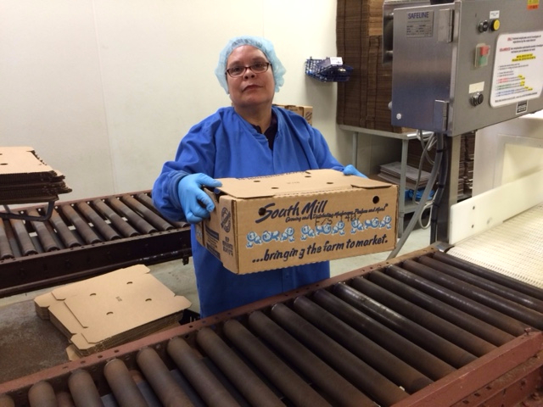
PACKING

Slide 9
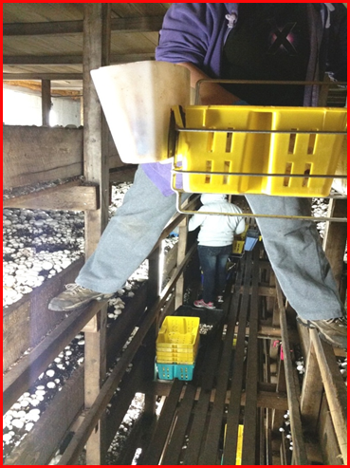
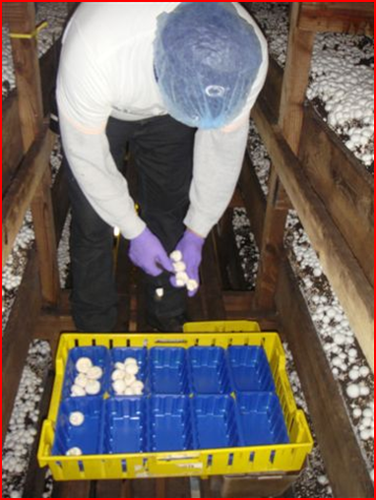
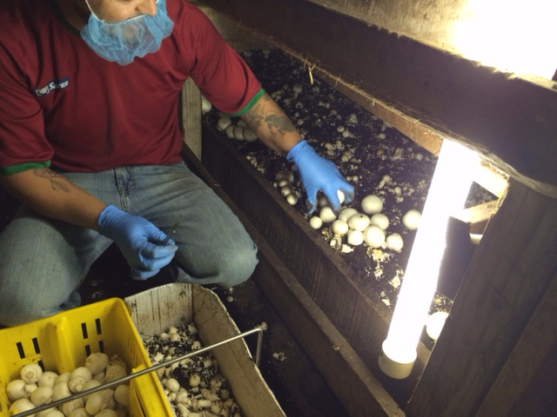
HARVESTING

Slide 10
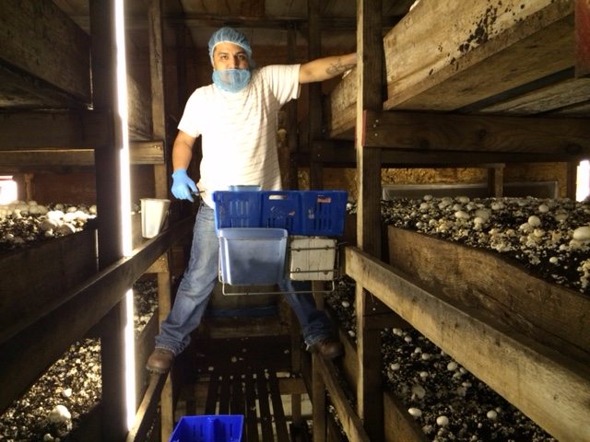
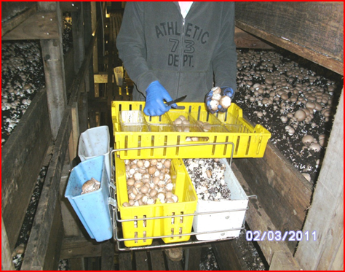
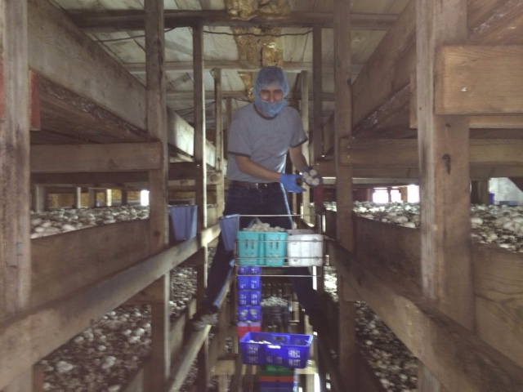
HARVESTING

Slide 11
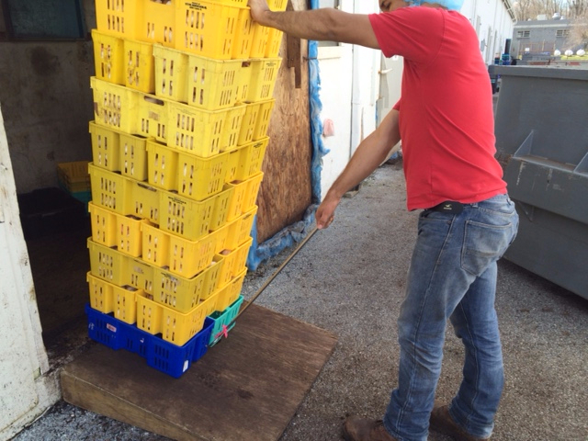
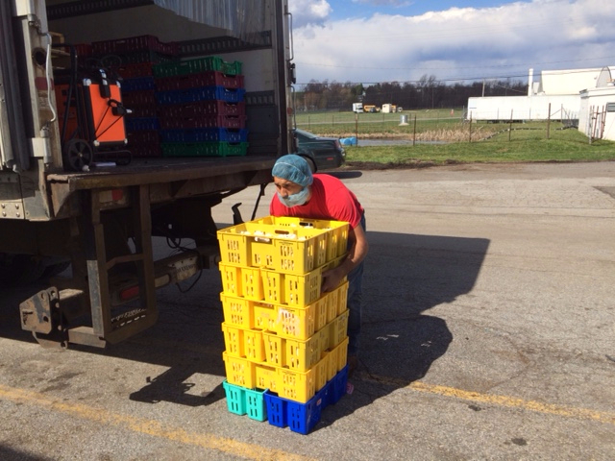
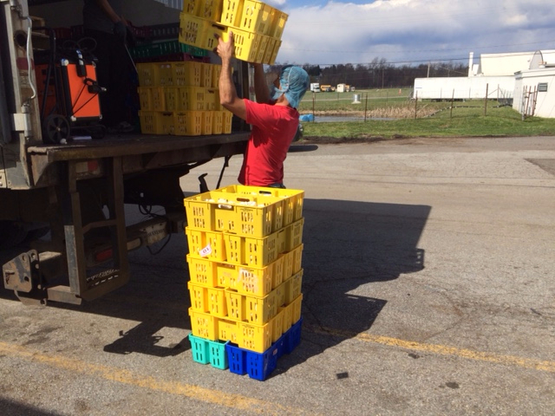
HAULERS

Slide 12
ERGONOMICS Sub-COMMITTEE
Meghan Klotzbach
meghan@organicmushrooms.com
Hilary Fox
hilary@phillipsmushroomfarms.com
Richard Rush
rrush@southmill.com
Chris Buckley
cbuckley@giorgiofoods.com
Jessica Chandler
jessica.chandler@atipt.com

