Slide 1


OSHA Update
American Mushroom Institute
General Meeting
April 27, 2017

Slide 2

Agenda:
OSHA Update
  Electronic Reporting
  Fatality Review
  Top 10 Violations
  Walking Working Surface Standard
  New penalty update (January 17, 2017)
  Q &A

Slide 3

Electronic Reporting
Amends 29 CFR 1904.41
May 11, 2016 Final Rule Posted For Public Review
Effective Jan. 1, 2017 Covered Employers with 250 Employees or more must submit (year 2016)- 300A by
July 1, 2017
Submit (year 2017)- 300, 300A, and 301s by
July 1, 2018
Thereafter by March 2nd

Slide 4

Electronic Reporting
Certain high-risk industries (NAICS 11 on the list)
Employers with 20 to 249 employees must submit
(year 2016)-300A and (year 2017)-300A by July 1st of
the following year
Beginning 2019 and every year thereafter the submission must be made by March 2nd
Additional Information and Q & As available now at:
http://www.osha.gov/recordkeeping/finalrule/index.html

Slide 5

Submission Year | Establishments With 250 or more Employees | *Establishments With 20-249 Employees | Submission deadline
2017 | Form 300A | Form 300A | July1, 2017
2018 | Forms 300A, 300, 301 | Form 300A | July 1, 2018
Releasing the data-
Encourage Employers to increase Efforts –The “nudge” to reduce injuries and illnesses
Enable researchers to access data to promote innovation in Safety and Health
PII will be removed

Slide 6
Rate of fatal workplace injuries
Per 100,000 workers
2015
1974-2001 data were estimated from BLS Survey of Employers
2002-2015 data were gathered from BLS Census of Fatal Injuries
In 2006, BLS switched from employment-based calculations to hourly calculations
Notes:
Update for 2015.

Slide 7
Fiscal Year 2017 Fatalities
October 1. 2016 – April 27, 2017
Philadelphia Area Office:
2 Construction- Fall into elevator pit
Fall to same level impaled
3 Gen. Industry- 2 PITs- caught under clamp
and caught under mast
1 caught under vehicle

Slide 8
1. Fall Protection
2. Hazard Communication
3. Scaffolding
4. Respiratory Protection
5. Lockout/Tagout
6. Powered Industrial Trucks
7. Ladders
8. Machine Guarding
9. Electrical – Wiring Methods
10. Electrical – General Requirements
Top Ten
Violations
Most frequently cited OSHA regulations
during inspections

Slide 9
Walking-Working Surfaces
and PPE (Fall Protection) Rule
Updates outdated subpart D
standard, incorporating new
technology & industry practices
Increases consistency with
OSHA’s construction standards
(CFR 1926 subparts L, M, and X)
Adds new provisions to Subpart I
that set forth criteria requirements
for personal fall protection equipment
CAUTION

Slide 10
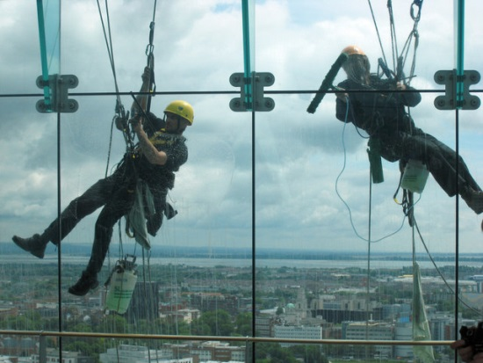
Walking-Working Surfaces
and PPE (Fall Protection) Rule
Rule overall: January 17, 2017
Ensuring exposed workers are trained on fall hazards (6 months),
Ensuring workers who use equipment covered by the final rule are trained (6 months),
Inspecting and certifying permanent anchorages for rope descent systems (1 year),

Slide 11
Walking-Working Surfaces
and PPE (Fall Protection) Rule
Rule overall: January 17, 2017
Installing personal fall arrest or ladder safety systems on new fixed ladders over 24 feet and on replacement ladders/ladder sections, including fixed ladders on outdoor advertising structures (2 years),
Ensuring existing fixed ladders over 24 feet, including those on outdoor advertising structures, are equipped with a cage, well, personal fall arrest system, or ladder safety system (2 years), and
Replacing cages and wells (used as fall protection) with ladder safety or personal fall arrest systems on all fixed ladders over 24 feet (20 years).

Slide 12
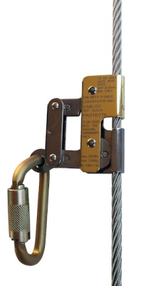
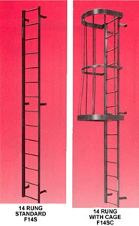
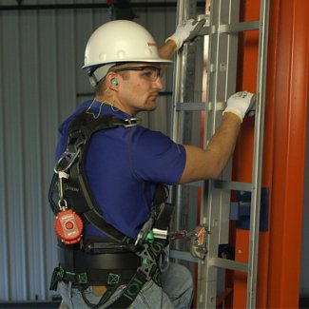
Ladder Safety Cage vs. Safety System

Slide 13

Walking-Working Surfaces
and PPE (Fall Protection) Rule
COMPLIANCE ASSISTANCE RESOURCES
OSHA’s new webpage on subparts D&I: www.osha.gov/walking-working-surfaces
Fact sheets
FAQs

Slide 14
New Penalty Levels
Adjusted Jan 17, 2017
Type of Violation | New Maximum*
Serious and Other-Than-Serious Posting Requirements | $12,675 per violation
Willful or Repeated | $126,749 per violation
Failure to Abate | $12,675 per day beyond the abatement date
*Maximum penalties will be readjusted annually for inflation.

Slide 15



Slide 16

Thank You!

