Slide 1
Disclaimer
This information is intended to assist employers, workers, and others as they strive to improve workplace health and safety. While we attempt to thoroughly address specific topics, it is not possible to include discussion of everything necessary to ensure a healthy and safe working environment in a presentation of this nature. Thus, this information must be understood as a tool for addressing workplace hazards, rather than an exhaustive statement of an employer’s legal obligations, which are defined by statute, regulations, and standards. Likewise, to the extent that this information references practices or procedures that may enhance health or safety, but which are not required by a statute, regulation, or standard, it cannot, and does not, create additional legal obligations. Finally, over time, OSHA may modify rules and interpretations in light of new technology, information, or circumstances; to keep apprised of such developments, or to review information on a wide range of occupational safety and health topics, you can visit OSHA’s website at www.osha.gov.

Slide 2
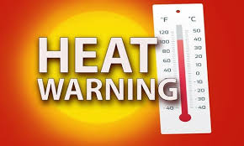
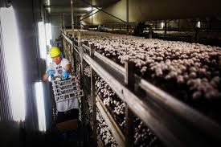

Heat Wave 2019
American Mushroom Institute Alliance

Slide 3

Why is Heat a Hazard to Workers?
The body cools by circulating blood closer to the skin and sweating. In most environments a very effective method for maintaining body temperature.
When the air temperature approaches
body temperature and the relative
humidity approaches the dew point
the body’s cooling plan looses
effectiveness.

Slide 4
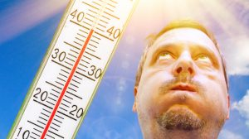
How do I know if it is too hot?
Temperature rises
Humidity increases
Sun gets stronger
Air movement stops
Torches, motors, pumps, heaters add heat
Work clothes and PPE keep in body heat
Lifting, moving, carrying causes the body to burn calories
and produce heat

Slide 5
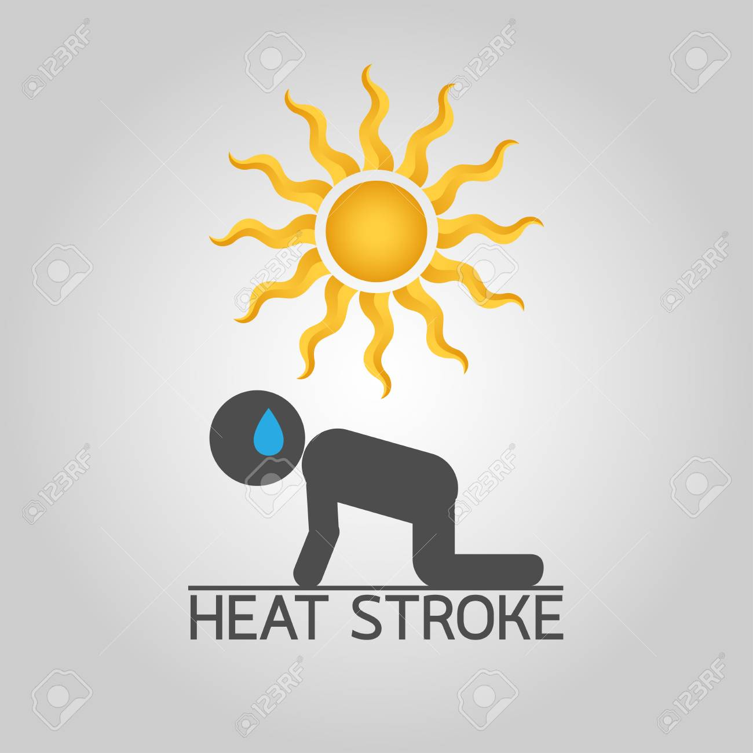
What happens to the body?
The body perspires profusely and the body loses salts and fluids
The body stores the heat and the core temperature rises
The heart rate increases
Muscles cramp
Dizziness and confusion«
Weakness and fatigue
Nausea
The body stops sweating

Slide 6
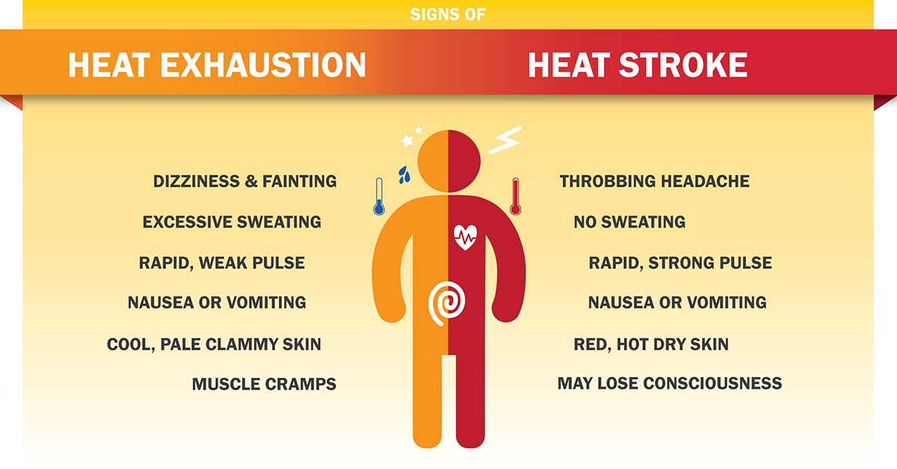

Slide 7
What happens to the body?
Heat Rash- skin irritation from the sweating
Heat Cramps-sweating depletes the salts
Heat Syncope-dizziness/fainting dehydration
Heat Exhaustion-heavy sweating, weakness,
dizziness/confusion, nausea, pale or flushed complexion, muscle cramps, slightly elevated body temp., fast shallow breathing
Heat Stroke-hot dry skin or sweating, chills,
slurred speech, hallucinations, headache

Slide 8
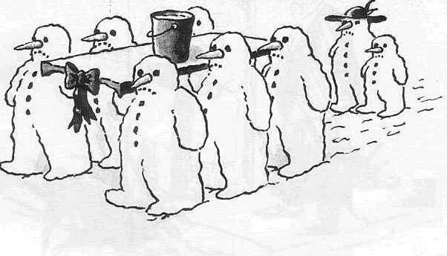
What happens next?

Slide 9
What can we do?
Employers can-
Engineering controls- such as?
Administrative controls- such as?
Is there PPE?
Provide Training- such as?
Employees can-
Wear light clothing
Avoid alcohol and drink more water
Monitor themselves and co-workers

Slide 10
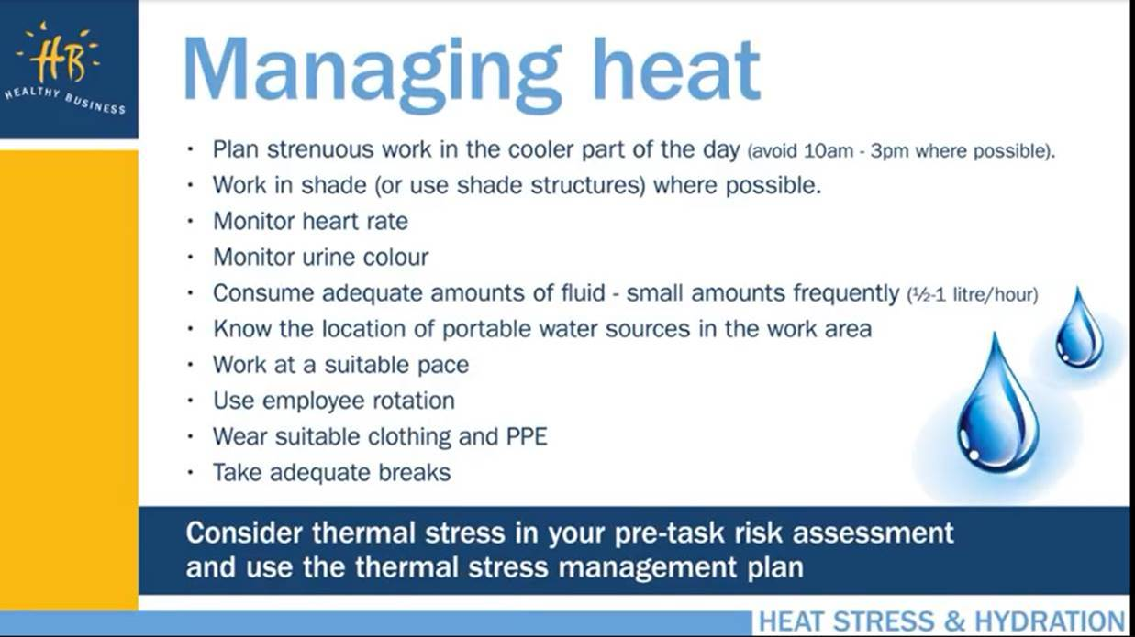

Slide 11

What’s New?

Slide 12
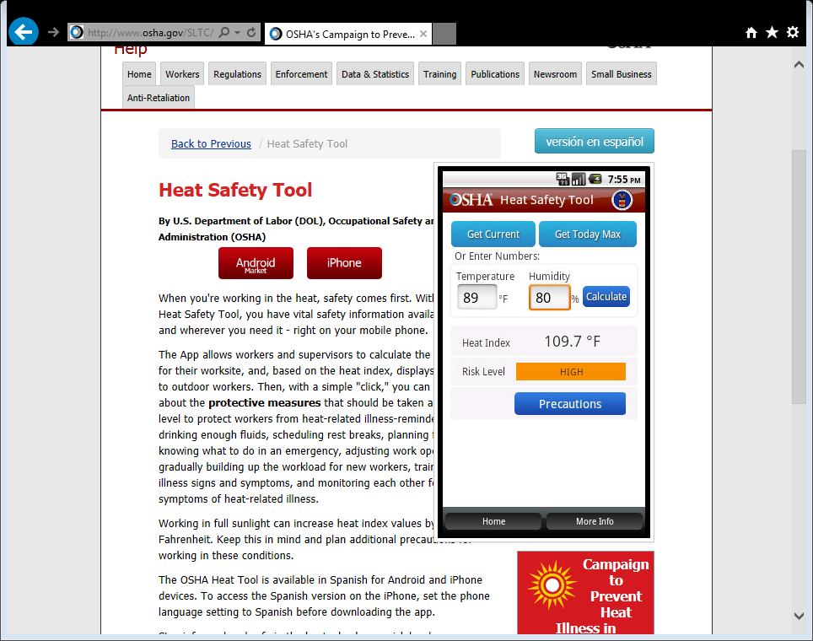

Slide 13
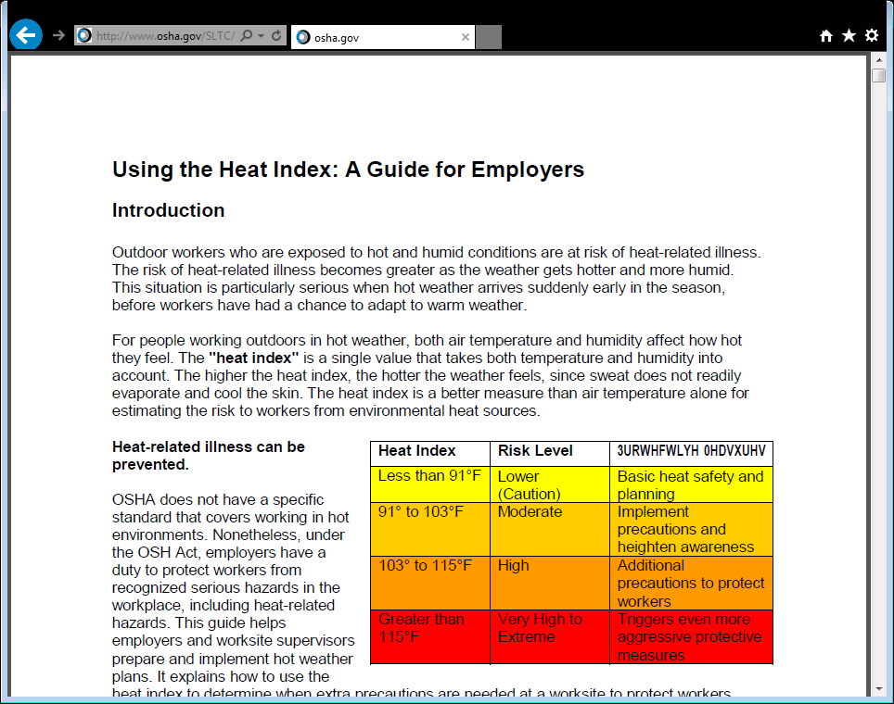

Slide 14

Water. Rest. Shade.

Slide 15
