Slide 1
“Building An Effective Safety Culture”
Amanda Alonso – Laurel Valley Farms
Richard Rush – South Mill - Champs
MESH Annual Meeting 4/18/19

Slide 2
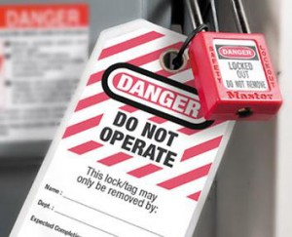
“Building An Effective Safety Culture”
LOTO Incident Scenarios
Worker fails to LOTO – Supervisors’ Reactions – “Wrong Way”
Worker fails to LOTO – Supervisor / Co-worker’s Reactions – “Right Way”

Slide 3
“Building An Effective Safety Culture”
LOTO Scenario Analysis
Both Supervisors reacted in the wrong way – one ignored situation and the other over-reacted
Worker helped co-worker to do right thing and Supervisor reinforced this behavior

Slide 4
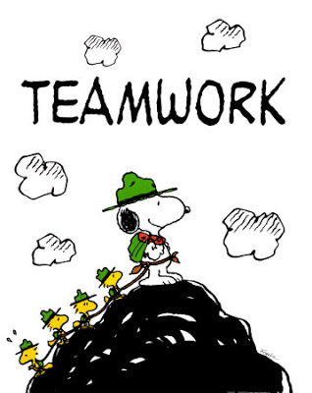
“Building An Effective Safety Culture”
Definition of “Culture” – A set of shared values and practices
Building a Safety Culture requires Teamwork

Slide 5
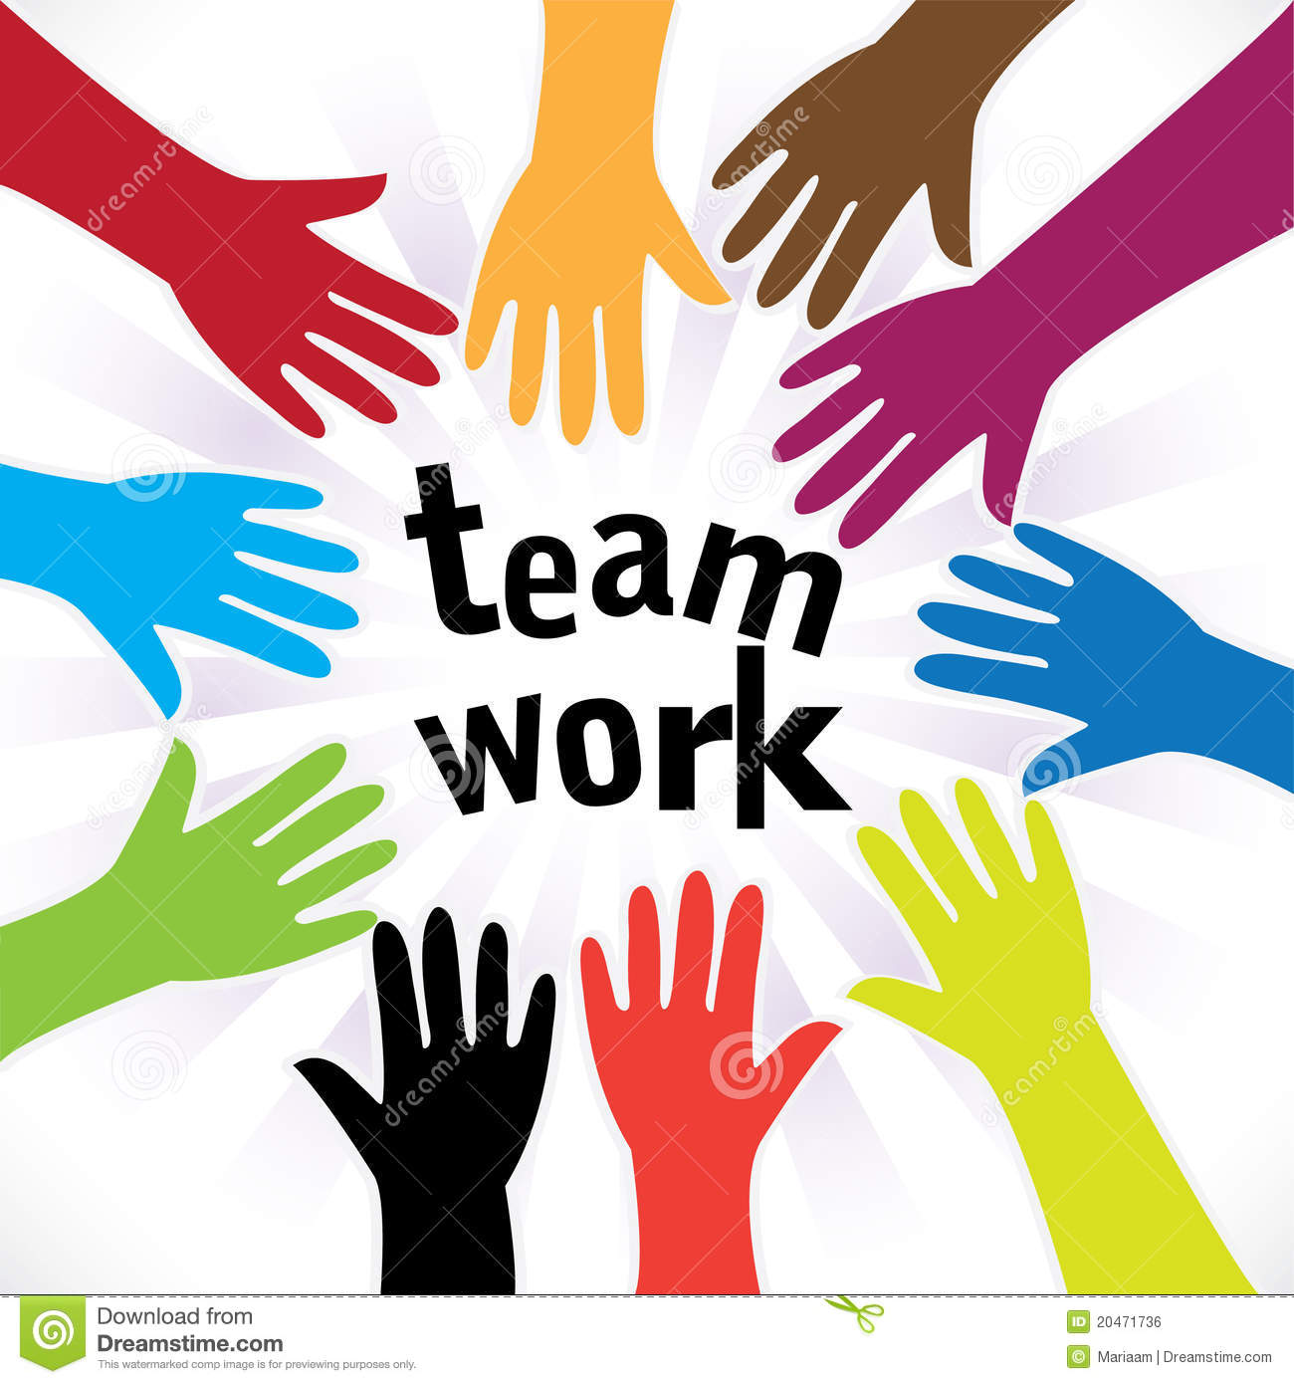
“Building An Effective Safety Culture”
Teamwork
“Teamwork is the essence of life. The key to teamwork is to learn a role, accept that role, and strive to become excellent playing it.” – Pat Riley (NBA Basketball Coach)
This Photo by Unknown Author is licensed under CC BY

Slide 6
“Building An Effective Safety Culture”
Safety Program Core Elements
Management Leadership – “Walk the Talk”
Worker Participation - Involvement
Proactive Approach – Address Hazards

Slide 7

“Building An Effective Safety Culture”
Key Building Blocks of Safety Culture
Communication
Empowerment
Respect
Trust

Slide 8
“Building An Effective Safety Culture”
Importance of Leadership
Scott Paper Company’s Southeast Timberlands
Safest Work Areas = Best Leadership / Most Productive / Best Quality / Most Efficient
Leadership - Lead by Example – “Walk-the-Talk”

Slide 9
“Building An Effective Safety Culture”
Safety Obligations
Obligated to personally work in a safe manner
Obligated to say something to others
Obligated to accept help from others

Slide 10
“Building An Effective Safety Culture”
Safety Obligations
Accountability
Empowerment / Communication
Respect

Slide 11
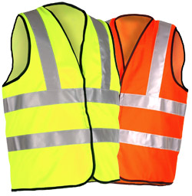
“Building An Effective Safety Culture”
Final Scenario
Passing of the Safety Vests
Communication + Empowerment + Respect = TRUST
Safety Culture Building Blocks

Slide 12

“Building An Effective Safety Culture”
Building a Safety Culture takes Teamwork
Total Involvement - Ownership to Management to Workers

Slide 13
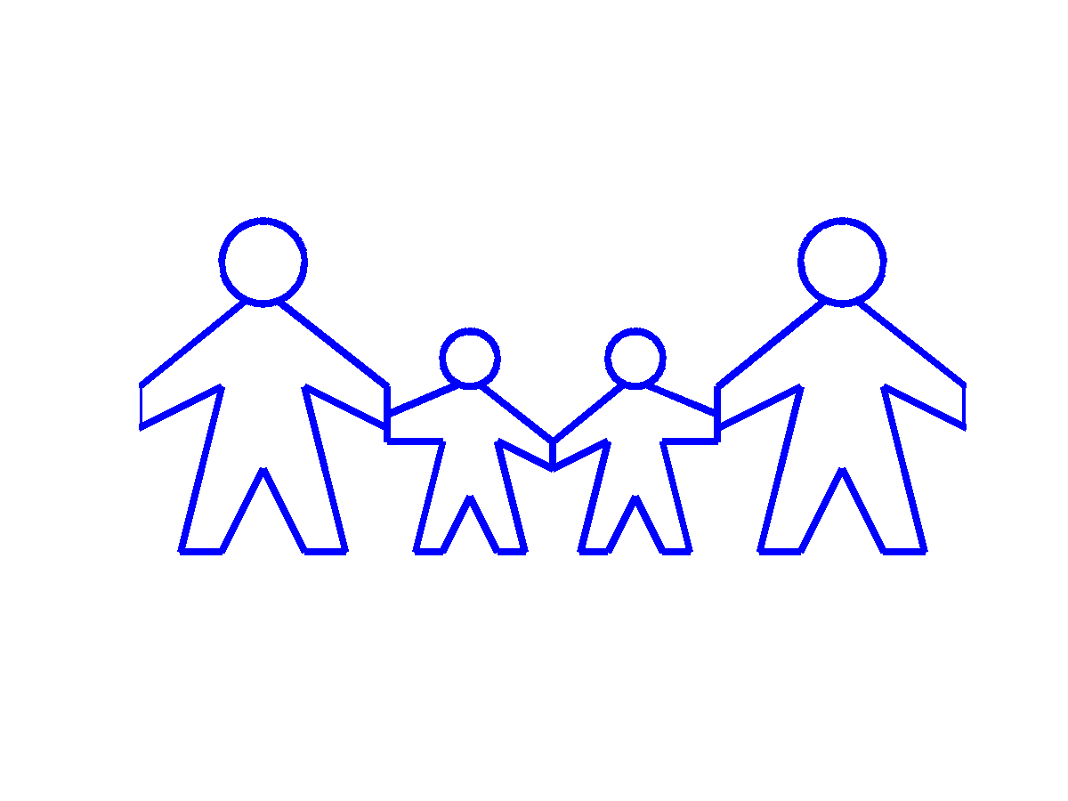
“Building An Effective Safety Culture”
Best way to build an Effective Safety Culture is to treat co-workers as your
Work Family

