Slide 1

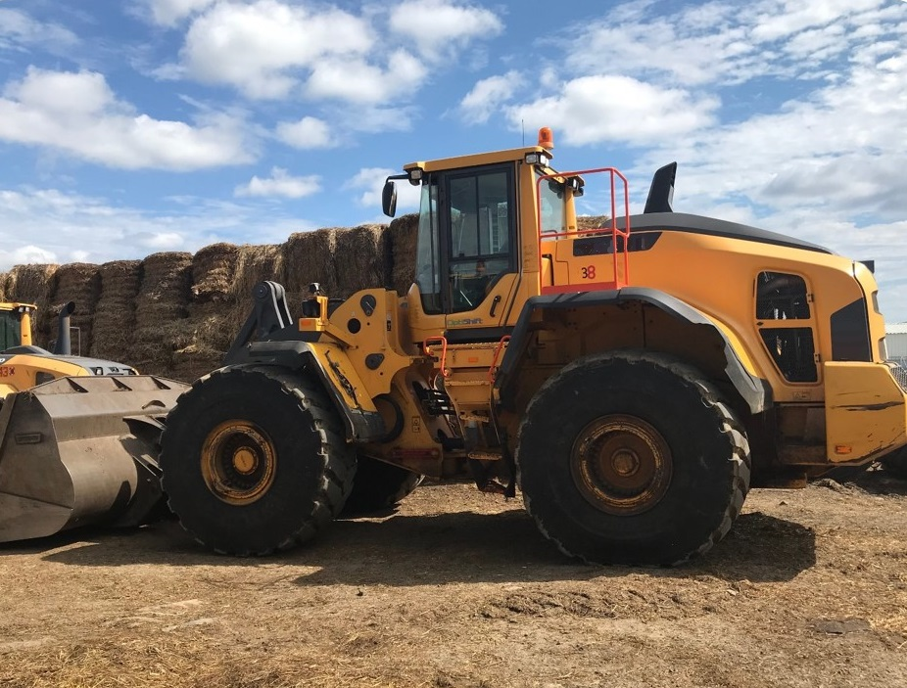
FRONT END LOADER SAFETY
[YOUR COMPANY NAME]

Slide 2

Pre-Operation Preparation Before Boarding Loader
Loader operators should wear high visibility vests and hats or other reflective clothing, especially if more than one loader is being operated at a time.

Slide 3
Pre-Operation Inspection Before Boarding Loader
Inspect the loader! Loader operators should:
Check tires for proper pressure
Ensure there are no cracks in roll over protection system (ROPS)
Make sure there is no damage to the unit

Slide 4
Pre-Operation Inspection Before Boarding Loader
Loader operators should:
Look for hydraulic leaks. Never use your hand to check for leaks.
Remember: a pinhole size leak can break the skin and inject hydraulic fluid into the bloodstream
Make sure the bucket is latched on the loader
Always reference the manufacturer training materials and operations manual for loader specific safety information

Slide 5

Boarding Loader
Make sure the steps and handholds are clear of mud, ice, and oil/grease
Use 3 points of contact
Always face the machine

Slide 6
Pre-Operation Inspection After Boarding
Make sure the floor board and foot pedals are clear of debris
Make sure the seatbelt is working properly
Warm up the machine
Hydraulic oil should be warm in order for the controls to work properly

Slide 7
Pre-Operation Inspection After Boarding
After starting the machine, make sure all controls work properly
Tilt the bucket all the way forward to ensure that the bucket is properly attached
Know the terrain of where the loader will be operated
Check for potholes, etc.

Slide 8
Operating the Loader
ALWAYS WEAR THE SEATBELT!!
Know the weight the loader can safely lift (owners manual or nameplate)
Avoid sudden starts and stops

Slide 9
Operating the Loader
Avoid potholes, ditches, and drainage washouts
When driving on hills:
Travel up and down, not horizontally
Keep the load up when operating on a hill
Keep the heaviest part of the loader uphill as the loader moves on uneven terrain

Slide 10
Operating the Loader
Drive cautiously and observe your company’s speed restrictions
Avoid quick turns, especially when bucket is full or raised
Load the bucket evenly considering the weight of the load compared to the capacity of the loader
Consider how the load will be carried as the bucket is lowered or elevated
Do not use indoors for extended periods of time
Make sure there is plenty of ventilation whenever the loader must be used indoors

Slide 11
Operating the Bucket
Be aware of overhead hazards
Power lines
Roof trusses
Overhead equipment
Keep the bucket level as the load is raised

Slide 12
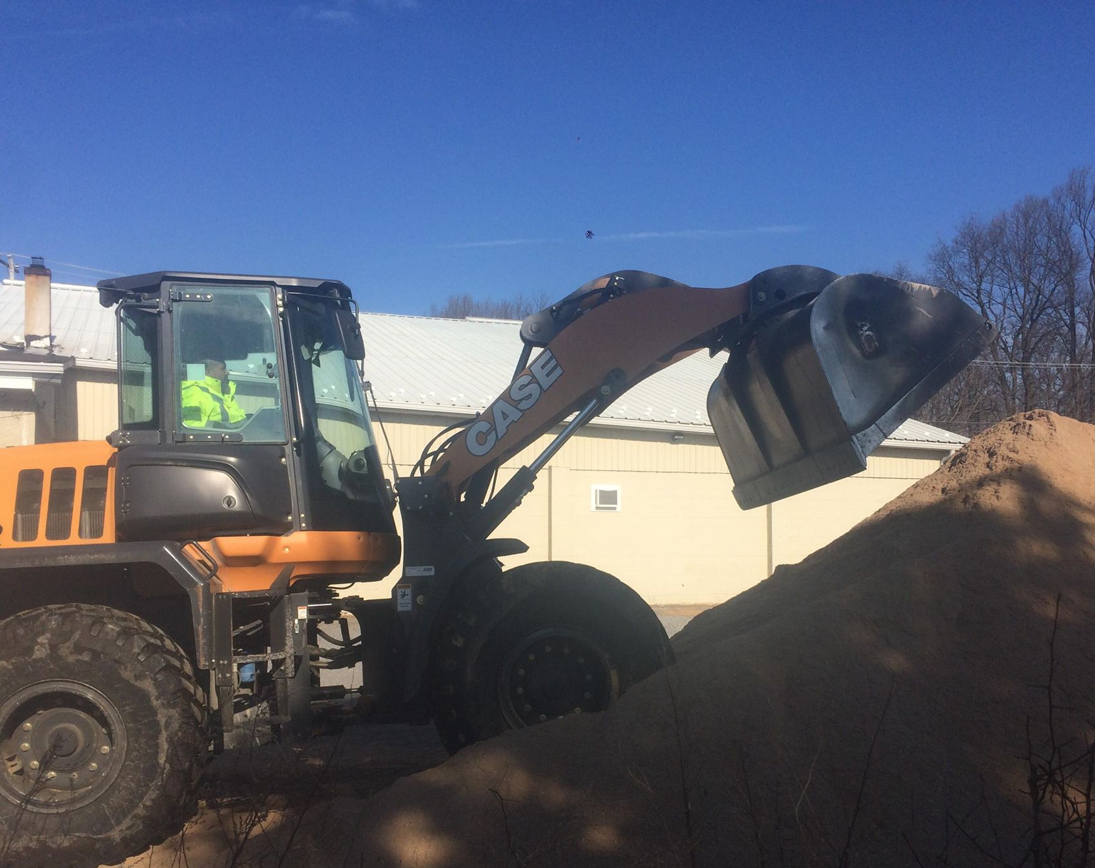
Operating the Bucket
If using a variety of attachments remember to properly secure them before using the machine
When stopping the machine, always lower the bucket or forks all the way to the ground so it is sitting flat

Slide 13
Operating the Bucket
Keep the bucket low especially when loaded
The higher the load, the higher the center of gravity
If the load is too high to see over, drive in reverse or use a trained spotter
When maintenance requires the bucket to be in a raised position, the arms need to be in a secured lock out tag out position to prevent the bucket from falling
Refer to your company’s specific lock out tag out procedures

Slide 14
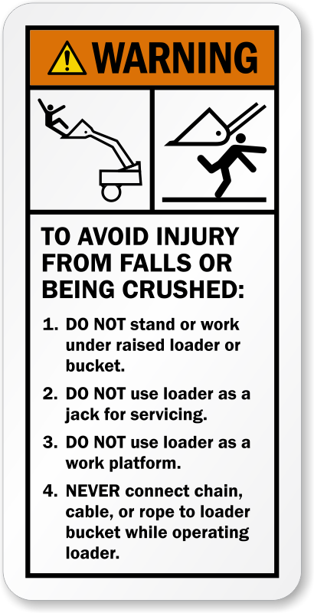
Never:
Never allow riders
On the steps
On the hitch
On the fenders
On the floorboard
In the bucket
Never start the machine from the ground or when not in a seated position and properly restrained
Never operate the hydraulic controls from the ground

Slide 15


Never:
Never use a handheld device while operating a loader
Come to a COMPLETE before answering ANY calls/texts
Drop bucket all the way down prior to using a handheld device
Never remove the ROPS
Pedestrians should never stand under the raised arms and bucket
Never jump off the machine
Never try using the bucket to remove fence post or tree stumps

Slide 16
Never:
Never move a raised bucket over people
Never allow anyone under the age of 18 operate the loader
Never move more material than the machine can handle; refer to the loader nameplate and manufacturer’s guidelines for weight capacity information
Never operate a loader if you have not been trained on that specific model

Slide 17
Weather Considerations
Loader operators should know how weather can impact their ability to operate the machines
Cold and rainy weather often leads to more steam, which can cause visibility problems

Slide 18
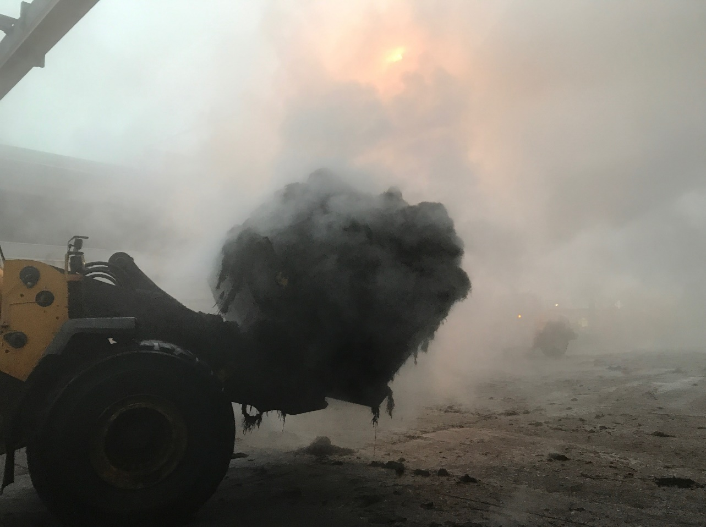
Operating Loaders in Steam
Steam occurs when it is cold or raining
It obstructs vision and creates a hazardous working environment

Slide 19
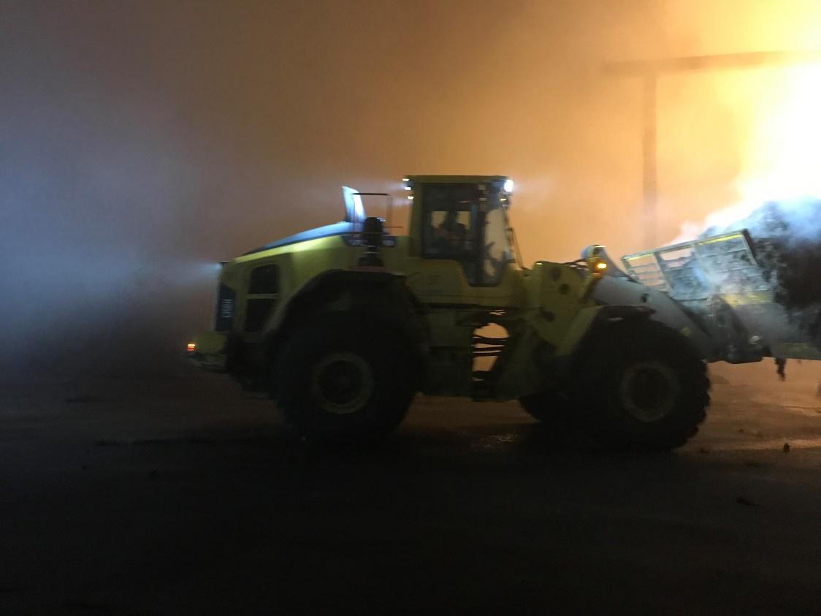
Operating Loaders in Steam
It is best to operate the loader in reverse when carrying a full load of steamy compost; go in this direction whenever possible.

Slide 20
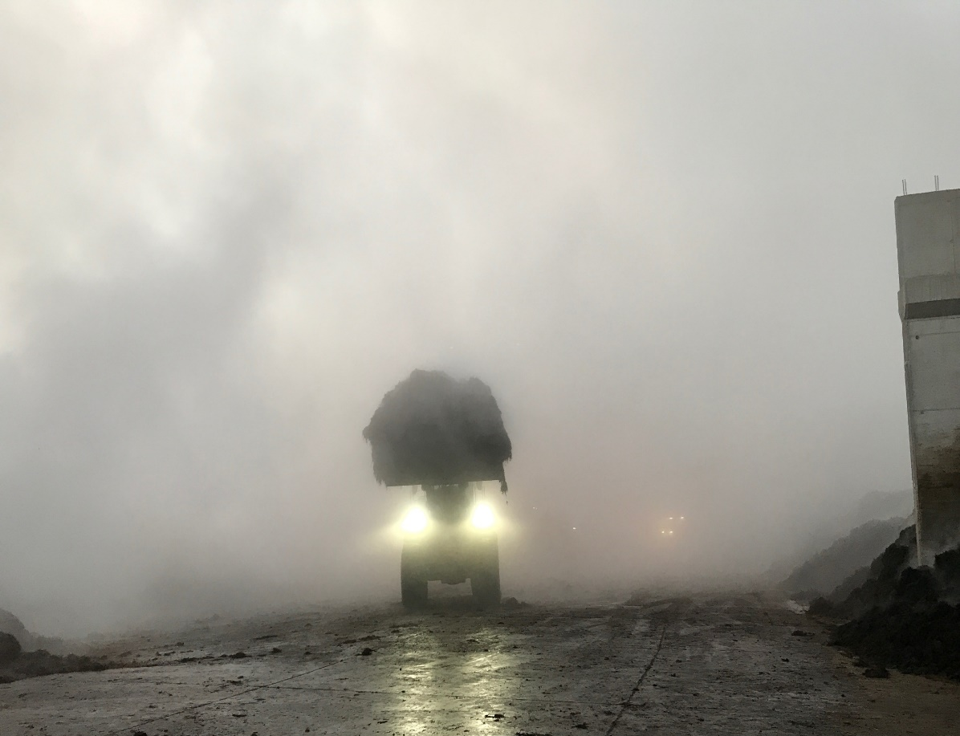
Operating Loaders in Steam
If for some reason operating the loader in reverse isn’t possible, carry the boom above the line of vision.

Slide 21
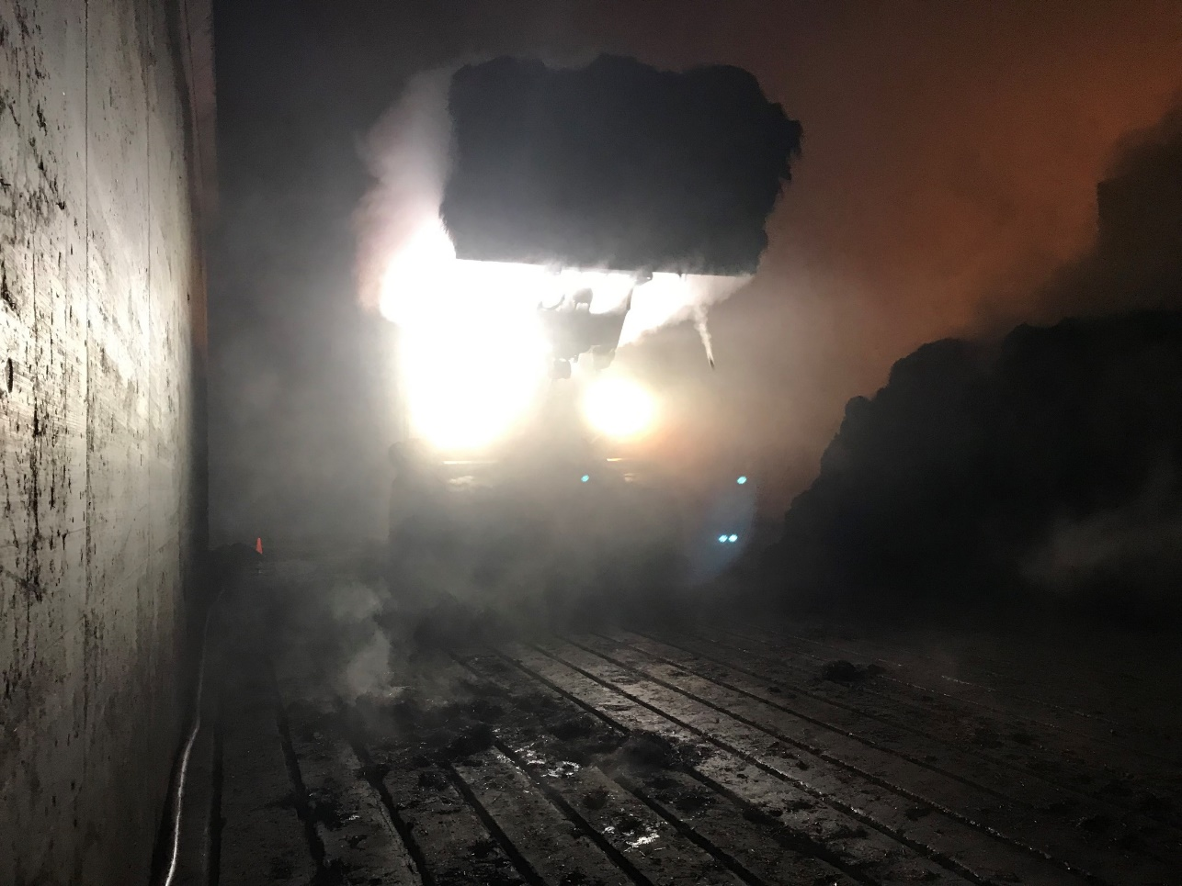
Operating Loaders in Steam
Only carry the boom above the line of vision when operating on a concrete pad or on even/level terrain.

Slide 22
Pedestrian Safety
Ground workers should be oriented on the usual traffic patterns and be aware of the low visibility danger zones
Ensure all pedestrians know to:
Make eye contact with loader operators before entering work areas and wait for the operator to acknowledge their presence (a wave or nod will suffice)
Never assume the operator sees you on the job site; be aware of loader blind spots
Alert the loader operator if they must move through the work area or if they leave the area

Slide 23
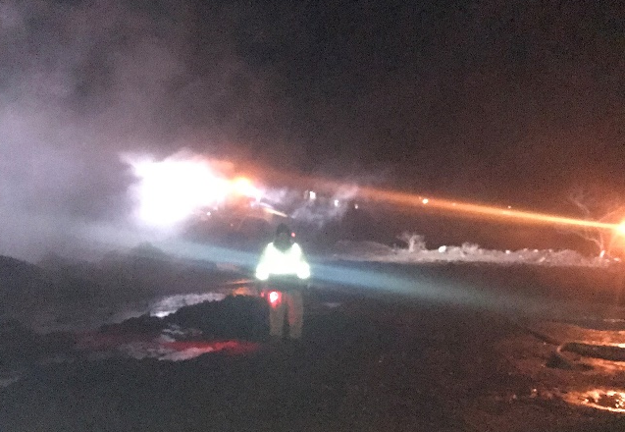


Pedestrian Safety
Ensure all pedestrians are wearing high visibility apparel/devices according to company policies
Consider using the following: LED flares, high visibility vests, reflective clothing

Slide 24

Pedestrian Safety
Minimize pedestrian traffic in loader operation areas
Create designated pedestrian zones if possible
For more information, read “Pedestrian Safety on the Farm” by Amanda Alonso and Jeremy Uncles, Laurel Valley Farms, available in the January 2019 issue of Mushroom News

Slide 25
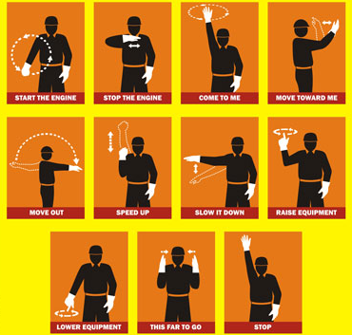
Standard Hand Signals

Slide 26
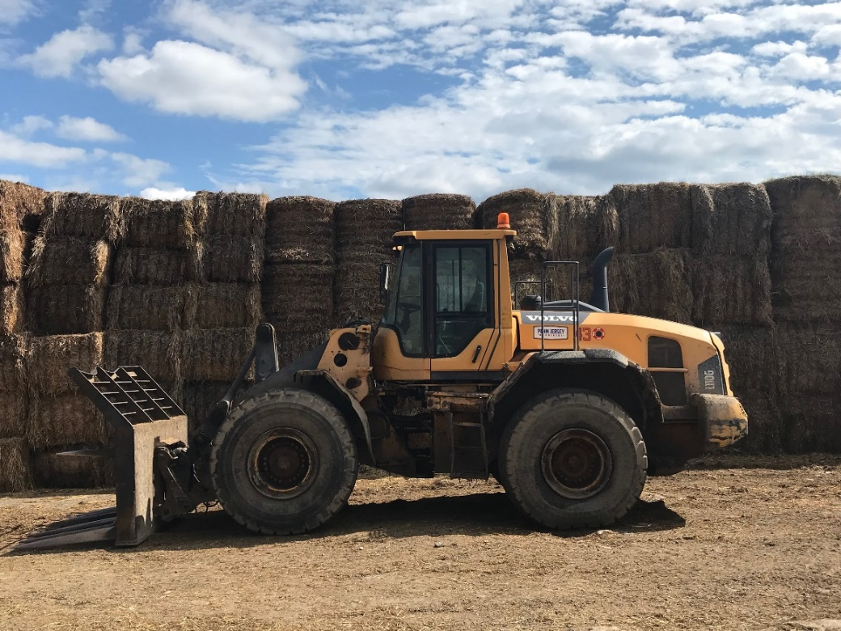
Articulating Loaders
This equipment turns in the middle of the machine
Watch for the pinch
hazard created by the
pivoting machine

Slide 27
Know the Terrain
Be aware of any hazards and obstacles on the job site
(Companies should list and insert photos of known site-specific hazards/obstacles)

Slide 28
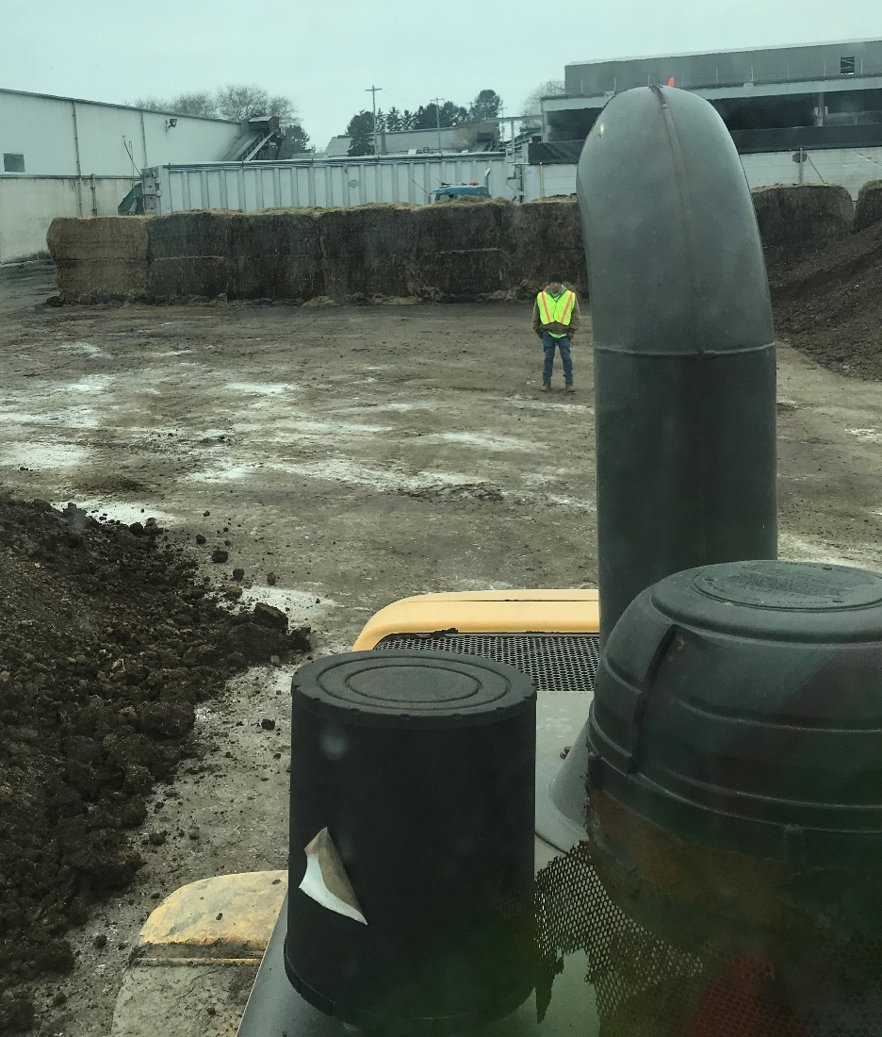
Most Common Accidents
Struck- by incidents-
Many of the fatalities listed on OSHA’s database were a result of a struck-by incidents. All too often ground personnel find themselves in a blind spot and an operator will strike them with the loader. Also the load carried by a front end loader can strike personnel on the ground causing serious injuries.

Slide 29
Most Common Accidents
2. Caught-in or between-
Similar to struck-by incidents, caught-in or between incidents are responsible for many injuries and fatalities. Workers can find themselves pinned in between the front end loader and another object such as a wall. The load the machine is carrying or working underneath the attachment in the front of the machine can also create an incident where a worker suffers a caught-in or between injury.

Slide 30
Most Common Accidents
3. Tip-overs-
When a front loader is operated outside of its design limits or in an unsafe way, they are susceptible to tip-over incidents. Loads that are too heavy, uneven terrain, and unsafe speeds are a few common factors for tip-over incidents.

Slide 31
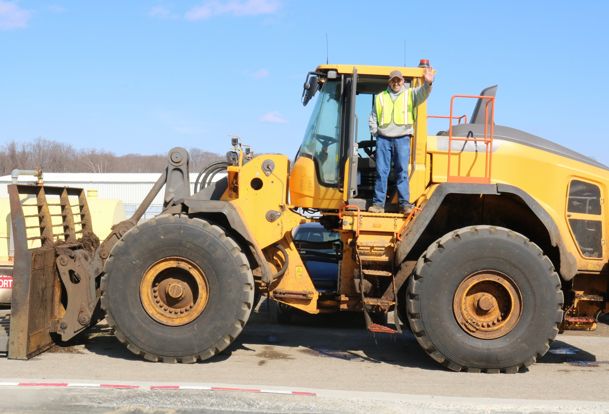
Questions

Slide 32
More Resources (for trainers)
To be connected with the Front End Loader Safety Subcommittee, contact AMI at info@americanmushroom.org or (610)268-7483.
Visit www.americanmushroom.org for more Front End Loader Safety resources as they become available

